Slide 1
Rank-based analysis of gene expression profiles and multi-omics characteristics for cancer
KTH-Royal Institute of Technology
Prof Adil’s lab
Xiangyu Li

Slide 2
High-throughput technologies
Expression profiles by sequencing or array
Methylation profiles by sequencing or array
Protein profiles by mass spectrometers
Batch effect
Handlers
Reagent lots
Laboratory conditions
Goh W W B, Wang W, Wong L. Why batch effects matter in omics data, and how to avoid them[J]. Trends in biotechnology, 2017, 35(6): 498-507.

Slide 3
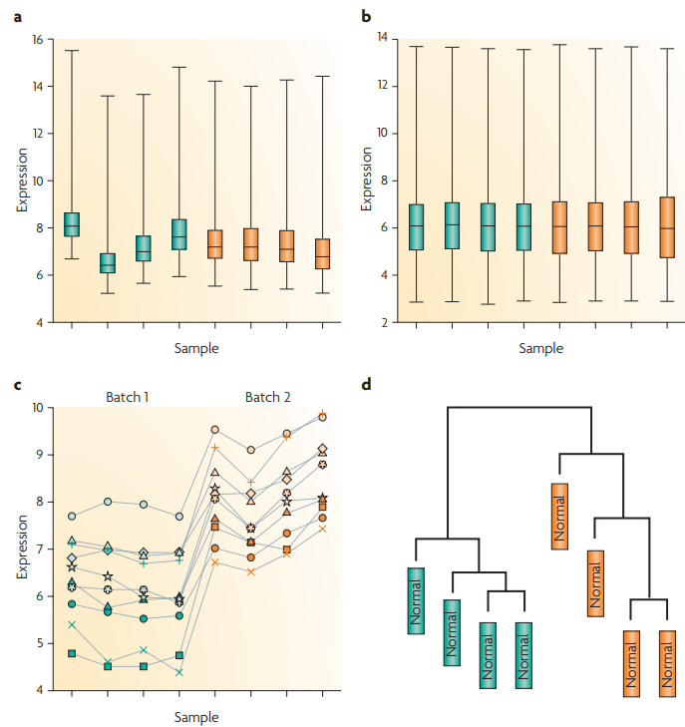
Batch effect
Raw data
Normalized data
Normalized data
Normalized data
Leek J T, Scharpf R B, Bravo H C, et al. Tackling the widespread and critical impact of batch effects in high-throughput data[J]. Nature Reviews Genetics, 2010, 11(10): 733.

Slide 4
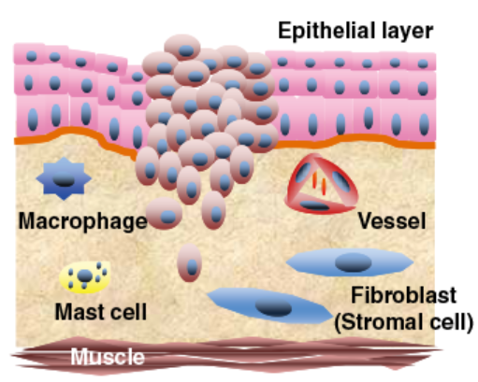
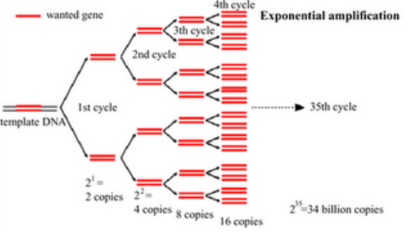
Poor quality of clinical samples
Tumor cell
Different proportions of tumor epithelial cells within different
sites for the same tumor tissue
RNA degradation during sample preparation and storage
Amplification bias for low-input samples
Formalin-fixed paraffin-embedded (FFPE) samples
VS
Fresh-frozen (FF) samples

Slide 5
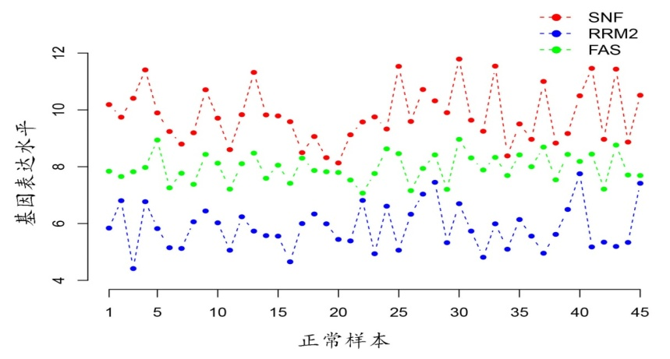
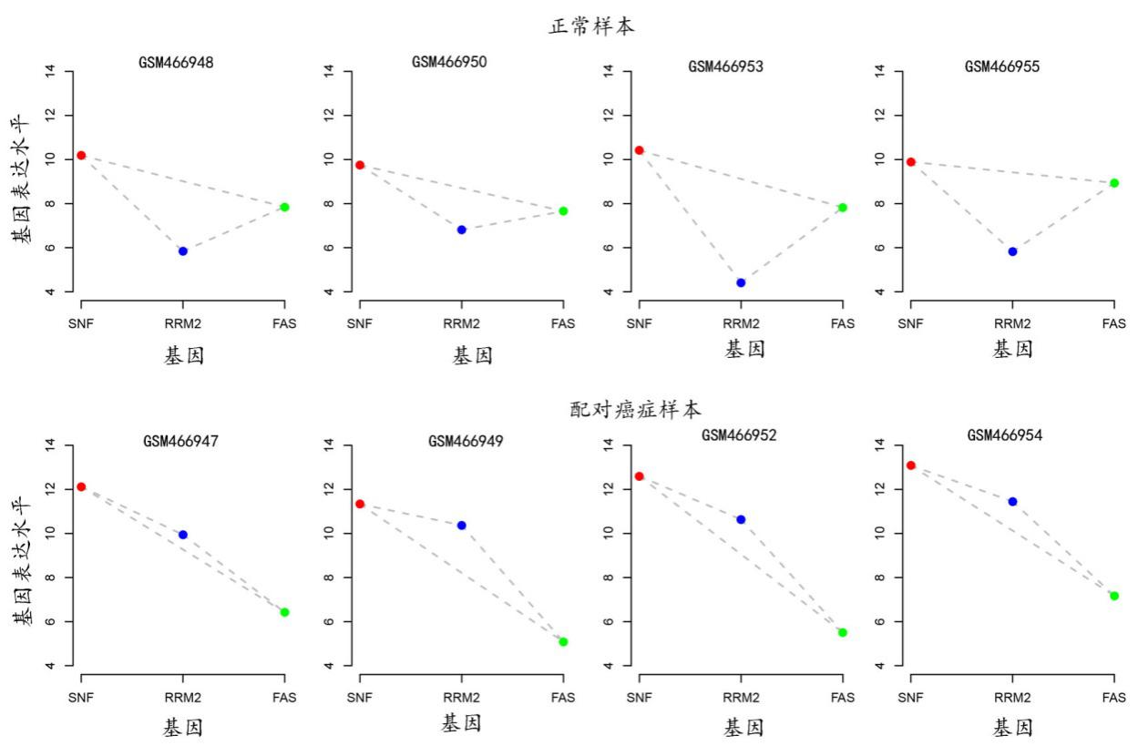
Relative expression orderings (REOs) of genes
REO patterns :
SNF > RRM2
SNF > FAS
FAS > RRM2
Log-intensity
Normal samples
Dataset 1
Dataset 2
Dataset 3
Dataset 4
Log-intensity

Slide 6
Advantages of REOs
Be insensitive to batch effect
Be invariant to monotonic data normalization
Be highly robust against the proportion variations of tumor cells, partial RNA degradation and amplification bias

Slide 7
Finding
The REOs of gene pairs are overall stable in one state of a particular type of human tissue (normal samples) but widely disturbed in another state (disease samples).
Normal samples
Dataset 1
Dataset 2
Dataset 3
Dataset 4
Log-intensity
Normal samples
Cancer samples
Dataset 1
Dataset 2
Dataset 3
Dataset 4
Log-intensity
Cancer samples

Slide 8
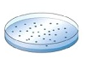
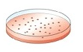
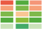
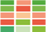
Aplication Ⅰ: CellComp algorithm
Identification of differentially expressed genes (DEGs) in small-scale cell line experiments
Limitations of commonly used methods
Student’s t-test/ SAM: Insufficient statistical power
Fold Change (FC): Lack of statistical control and produce selection bias
Control-1
Control-2
Control-3
Case-1
Case-2
Case-3
Li X, Cai H, Wang X, et al. A rank-based algorithm of differential expression analysis for small cell line data with statistical control[J]. Briefings in bioinformatics, 2017.
CellComp is available online at https://github.com/pathint/reoa .

Slide 9
Finding
The REOs of gene pairs are overall stable in a cell line but widely disturbed after a certain treatment.
Control cell line
Treated cell line
Gene D
>
Gene B
>
Gene C
>
Gene A
Gene A
>
Gene B
>
Gene C
>
Gene D
C₁ C₂ C₃ T₁ T₂ T₃

Slide 10
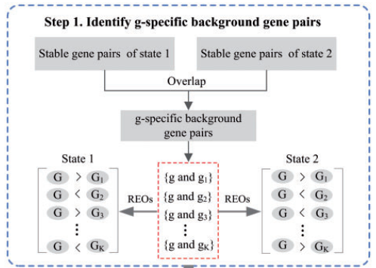
CellComp: step 1
Take gene g as an example.
G denotes the expression value of gene g.
Identify stable gene pairs including g in the state 1 and state 2.
REO comparison is limited to the overlapped gene pairs of the lists of stable gene pairs.

Slide 11
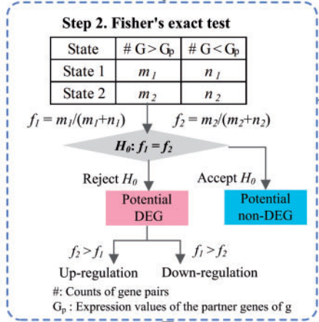
CellComp: step 2
G_{p} denotes the expression values of the partner genes of g.
m₁ and m₂ denote the numbers of gene pairs in which g shows a higher expression level than its partner genes in state 1 and state 2.
n₁ and n₂ denote the numbers of gene pairs in which g shows a lower expression level than its partner genes in state 1 and state 2.
The null hypothesis is that f₁ = f₂.

Slide 12
Dataset
Data accession | Cell line | Cancer type | Treatment | Size
GSE29084 | HepG2 | Liver cancer | HNF4A knockdown | 2 VS 2
GSE38581 | MKN45 | Gastric cancer | Hsa-miR-29c transfection | 2 VS 2
GSE38581 | MKN74 | Gastric cancer | Hsa-miR-29c transfection | 2 VS 2
GSE31450 | SNU638 | Gastric cancer | LAP2β transfection | 3 VS 3
E-MEXP-1691 | HCT116 | Colon cancer | 5-FU-treatment for 24h | 3 VS 3
GSE35004 | Hep3B | Liver cancer | YAP knockdown | 3 VS 3
GSE78167 | MCF7 | Breast cancer | Estrogen-treatment for 2h | 3 VS 3

Slide 13
Performance in simulated data
Sensitivity, specificity and F-score of DEGs identified by CellComp, RankComp, SAM, limma and RP for simulated data
FDR | Evaluation | HepG2 (2vs2) |  |  |  |  | SNU638 (3vs3)
 |  | CellComp | RankComp | SAM | limma | RP | CellComp | RankComp | SAM | limma | RP
1% | Sensitivity | 0.709 | 0.628 | 0 | 0.025 | 0 | 0.956 | 0.736 | 0.475 | 0.648 | 0
 | Specificity | 1 | 1 | 1 | 1 | 1 | 0.999 | 0.999 | 1 | 1 | 1
 | F-score | 0.829 | 0.772 | 0 | 0.049 | 0 | 0.977 | 0.848 | 0.644 | 0.786 | 0
5% | Sensitivity | 0.726 | 0.644 | 0.041 | 0.197 | 0.015 | 0.965 | 0.744 | 0.635 | 0.878 | 0.288
 | Specificity | 1 | 1 | 1 | 1 | 1 | 0.999 | 0.999 | 1 | 1 | 1
 | F-score | 0.842 | 0.784 | 0.079 | 0.328 | 0.029 | 0.982 | 0.853 | 0.777 | 0.935 | 0.447
10% | Sensitivity | 0.798 | 0.755 | 0.345 | 0.393 | 0.058 | 0.970 | 0.755 | 0.802 | 0.936 | 0.506
 | Specificity | 1 | 1 | 0.994 | 1 | 1 | 0.999 | 0.999 | 1 | 1 | 1
 | F-score | 0.888 | 0.860 | 0.508 | 0.564 | 0.109 | 0.984 | 0.860 | 0.890 | 0.967 | 0.672

Slide 14
Performance in real data
In the datasets with two replicates, SAM, limma and RP only detected 0-57 DEGs.
In the datasets with three replicates, above 65% of DEGs detected by SAM, limma and RP were detected by CellComp.
All the DEGs identified by RankComp were detected by CellComp in all the seven datasets.

Slide 15
Application Ⅱ: Metastasis predictive signature
1.Uncertainty of clinical metastasis detection
False positive and/or false negative of clinical imaging techniques
False negative of routine pathological examinations
Low sensitivity and specificity of serum biomarkers
2. Limitations of risk score summarized from the expression values of signature genes
Batch effect
Different proportions of tumor cells
RNA degradation
Amplification bias

Slide 16
Development flowchart
Affymetrix
Illumina-Hiseq
GC107
Ⅳ VS Ⅰ
GC73
Ⅳ VS Ⅰ
Overlap
Identify the overlapped gene pairs of the two lists of reversal gene pairs from two platforms
FDR<20%
22, 089
Metastasis-related gene pairs
Training
GC77(Ⅱ-Ⅲ)
Greedy algorithm
C-index maximization
Training
Signature extraction
19 gene pairs
(19-GPS)
Independent validation
Survival analysis
GC71（Ⅱ-Ⅲ）
Survival analysis
GC46（Ⅱ-Ⅲ）
Independent validation

Slide 17
19 gene pair signature
19-GPS | REOs (E_{i} > E_{j}) | C-index
Gene pair 1 | COL8A1 > *** | 0.66
Gene pair 2 | NALCN > *** | 0.63
Gene pair 3 | COMP > *** | 0.63
Gene pair 4 | GEM > *** | 0.62
Gene pair 5 | CMTM3 > *** | 0.62
Gene pair 6 | SFTA2 > *** | 0.59
Gene pair 7 | APOD > *** | 0.59
Gene pair 8 | OSMR > *** | 0.58
Gene pair 9 | ZNF311 > *** | 0.58
Gene pair 10 | COMP > *** | 0.58
Gene pair 11 | CDKN1A > *** | 0.58
Gene pair 12 | SERPINE2 > *** | 0.57
Gene pair 13 | SIT1 > *** | 0.57
Gene pair 14 | EFNA5 > *** | 0.55
Gene pair 15 | ZNF18 > *** | 0.55
Gene pair 16 | MGC16275 > *** | 0.53
Gene pair 17 | ITPRIP > *** | 0.53
Gene pair 18 | ARHGAP22 > *** | 0.52
Gene pair 19 | TMEM204 > *** | 0.52
Classification rule:
A sample was determined to be high risk if at least half of REOs of the 19 gene pairs within this sample voted for high risk; otherwise, low risk.
Note: E_{i} > E_{j} votes for high risk, otherwise, low risk.

Slide 18
Survival analysis

Slide 19
Aplication Ⅲ
5-Fluorouracil-based chemotherapy resistent predictive signature for gastric cancer and distinct multi-omics characteristics of prognostic groups
1. Uncertainty of drug resistance detection
Different tumor response metrics (WHO/RECIST/RECIST1.1)
Underestimate the effect of drugs
Deviation of SUV value of PET
2. Retrospective prediction
3. Limitations of signature based on risk score

Slide 20
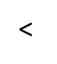
5-Fu resistant predictive signature
KCNE2
<
PRPF3
Resistance
KCNE2
API5
Resistance
For an individual patient
Count=2
Count<2
High-risk
Low-risk
A patient would be predicted to be resistant to 5-FU if and only if KCNE2 had lower expression level than both PRPF3 and API5.

Slide 21
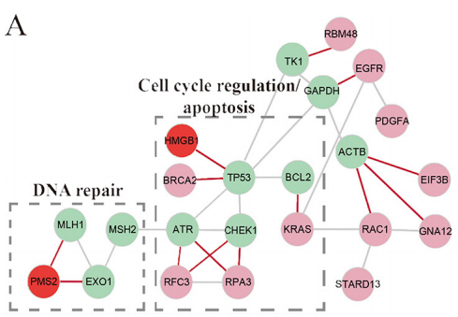
Multi-omics characteristics
Copy number alterations
The 5-FU resistance patients have significantly higher frequencies of copy number gain at seven regions.
The 85 genes located in the seven regions displayed significant overexpression in the 5-FU resistance samples and were significantly enriched in the mismatch repair pathway.
In PPI network analysis, these genes with copy number gains mainly impacted the cell cycle, DNA repair and apoptosis pathways.

Slide 22
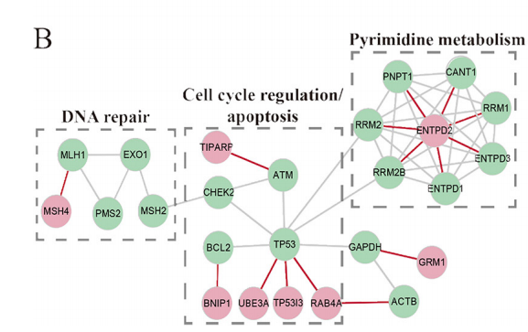
Multi-omics characteristics
Somatic mutation
Among the 156 genes whose mutation frequencies were significantly different between the 5-FU sensitivity and resistance groups, 155 gene had higher frequencies in the 5-FU sensitivity groups.
These 155 mutation genes were significantly enriched in Wnt signaling, Ras signaling and autophagy pathways.
In the PPI network analysis, these mutated genes mainly impacted the pyrimidine metabolism, DNA repair, cell cycle and apoptosis pathways.

Slide 23
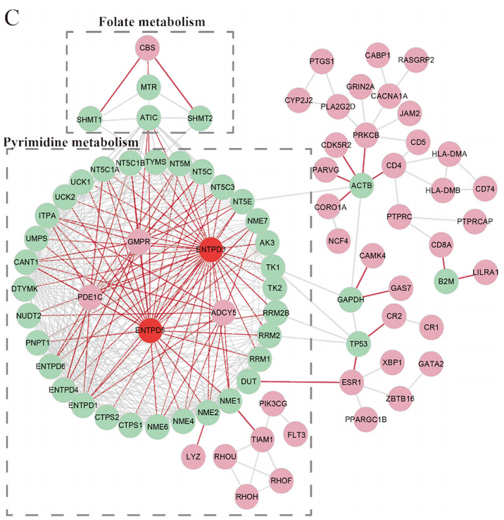
Multi-omics characteristics
DNA methylation alternations
The downregulation of 400 genes were induced by hypermethylation.
The 400 genes were significantly enriched in the cell adhesion pathway.
In the PPI network analysis, these genes mainly impacted the pyrimidine metabolism and folate metabolism pathways.

Slide 24
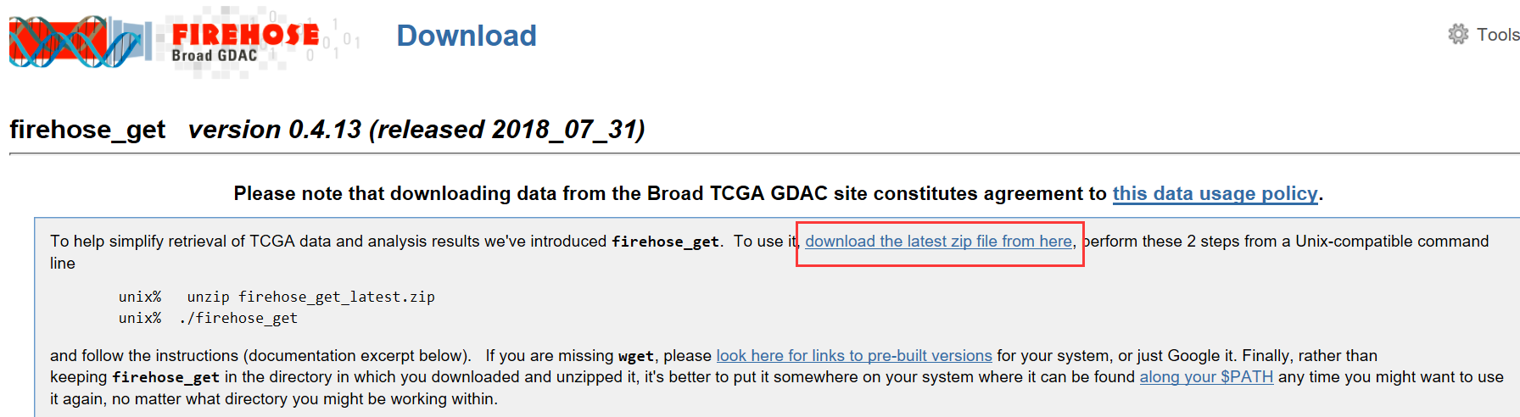
Firehose: Copy number data
Firehose: https://confluence.broadinstitute.org/display/GDAC/Download
Download the firehose_get file (version 0.4.13, released 2018_07_31)

Slide 25
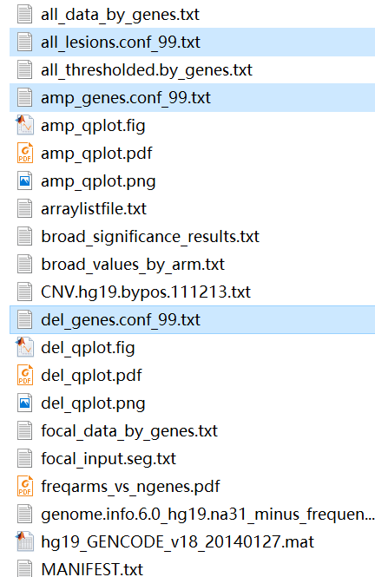
Firehose usage
Try chmod +x firehose_get to provide executable permission
Test firehose: ./firehose_get
Download the copy number data processed by Gistic2 algorithm:
./firehose_get –only CopyNumber_Gistic2 analyses latest STAD
We only need three files:
all_lesions.conf_99.txt: regions, amplication or deletion information
amp_genes.conf_99.txt: amplification regions, genes
del_genes.conf_99.txt: detetion regions, genes

Slide 26
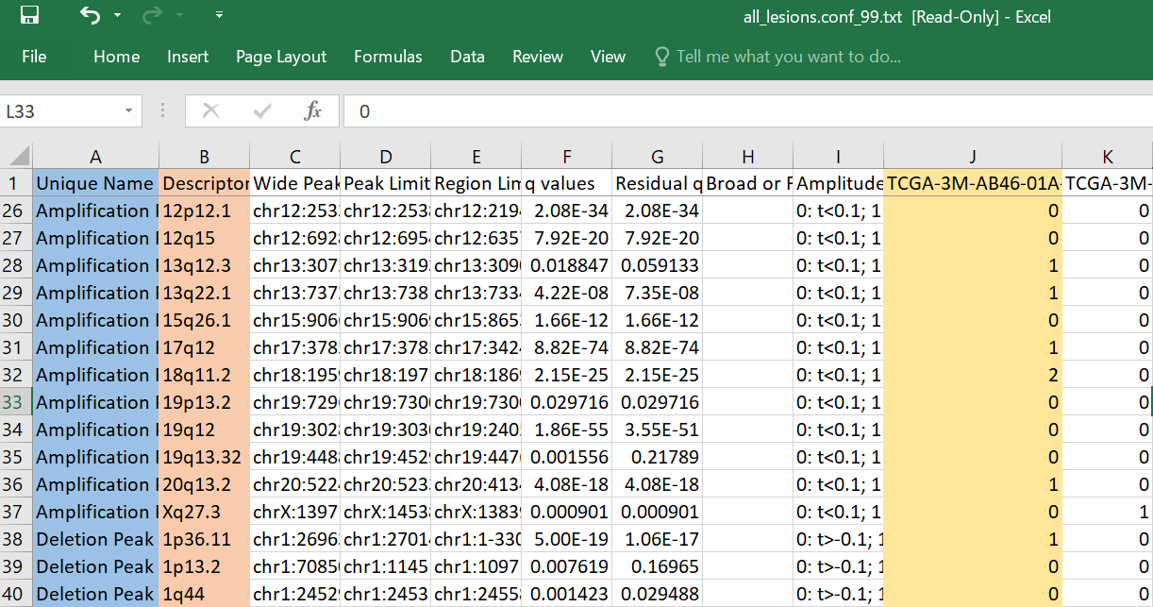
all_lesions.conf_99.txt

Slide 27
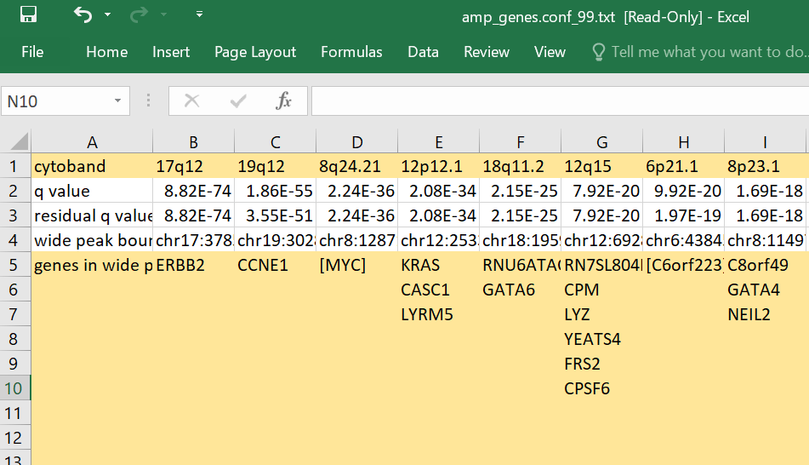
amp_genes.conf_99.txt

Slide 28
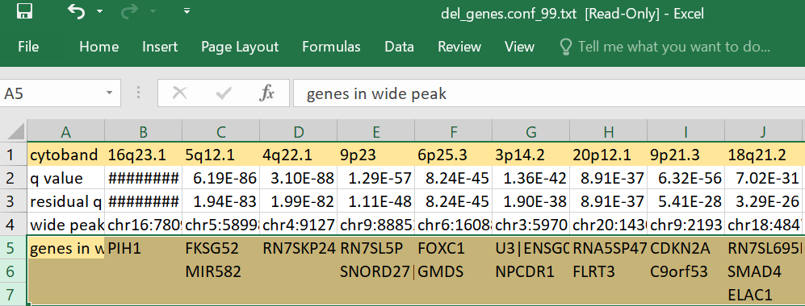
del_genes.conf_99.txt

Slide 29
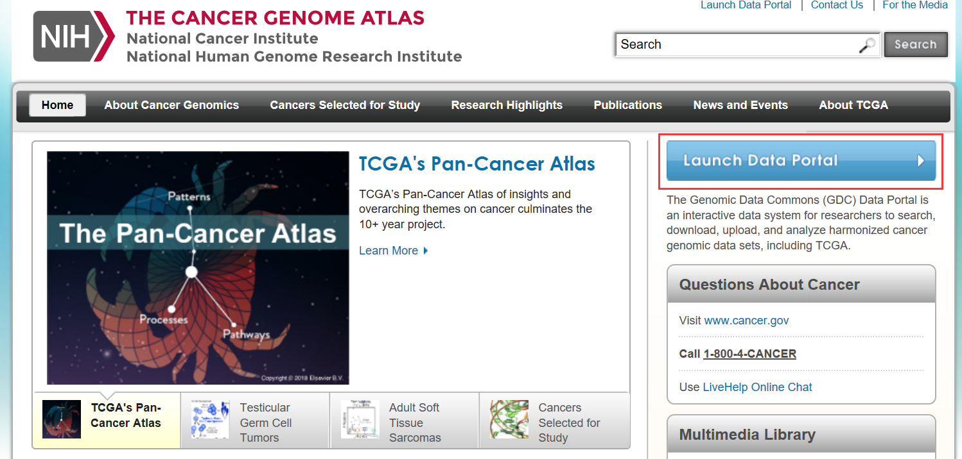
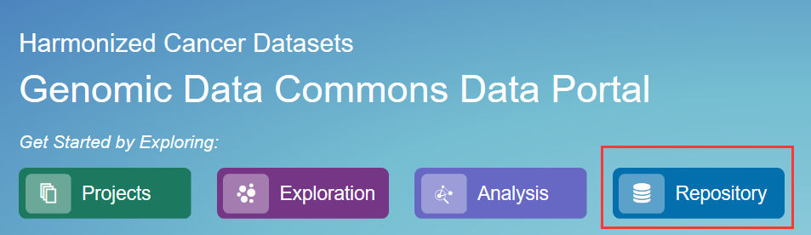
Somatic mutation data
The Cancer Genome Atlas: https://cancergenome.nih.gov/

Slide 30
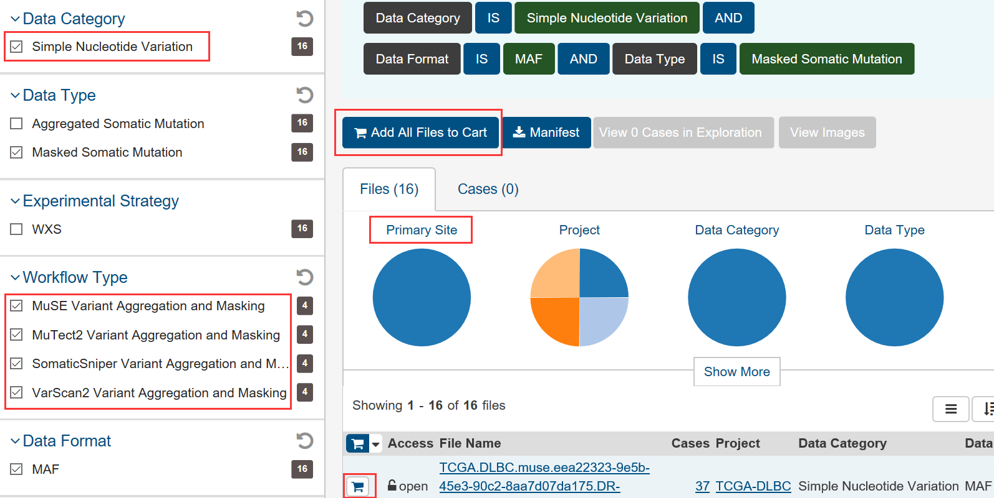
Select an omic
Add all samples to cart
Mutation calling algorithms
Or add the samples you want to cart

Slide 31
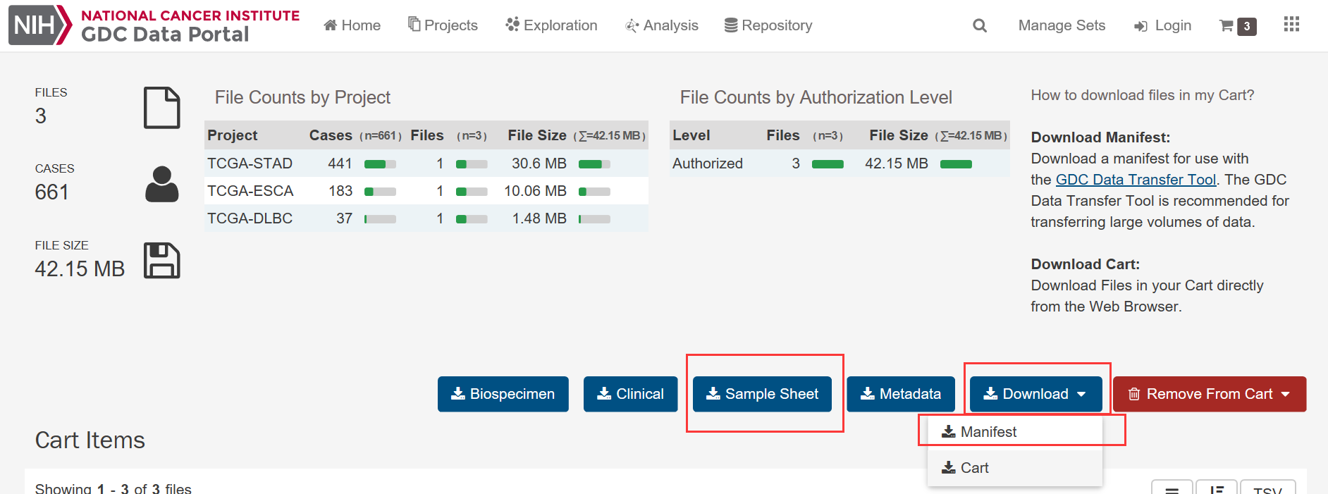
The samples you want are added
Manifest: file id
Sample sheet: file id and sample id

Slide 32
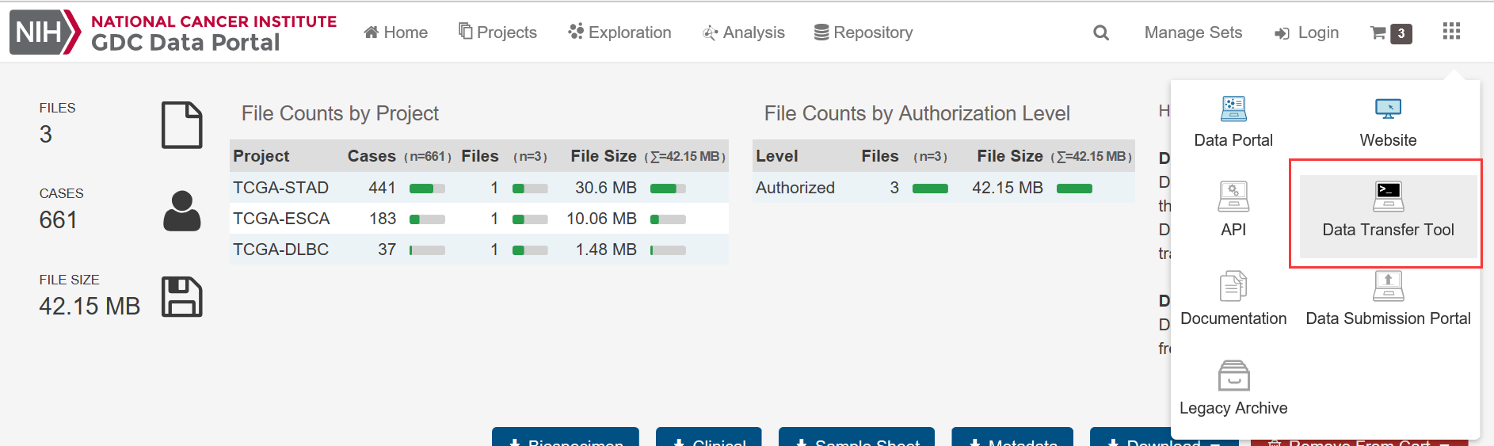
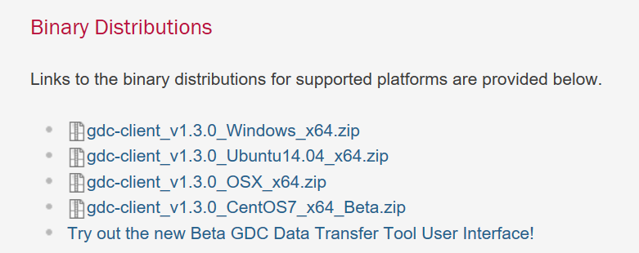
The tool for bulk download

Slide 33
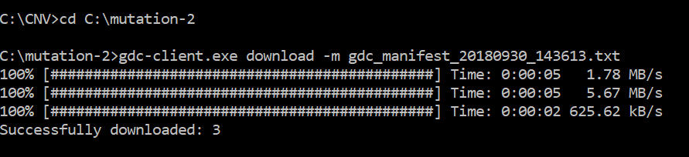
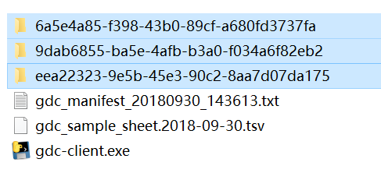
Open cmd
Code: gdc-client.exe download -m manifest_file_name
eg. gdc-client.exe download -m gdc_manifest_20180930_143613.txt
Note: Put the manifest file and gdc-client.exe in the same folder.
Successfully downloaded

Slide 34
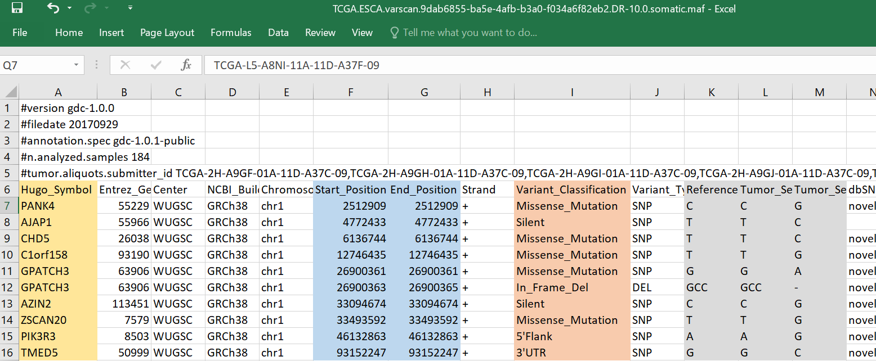
Somatic mutation data (Varscan)
Mutated gene
Position in genome
Mutation type
Reference loci and
mutated loci

